Slide 1

DC to Azure Migration Workshop
Dik van Brummen and Herb Prooy, the CloudLab on behalf of Microsoft

Slide 2
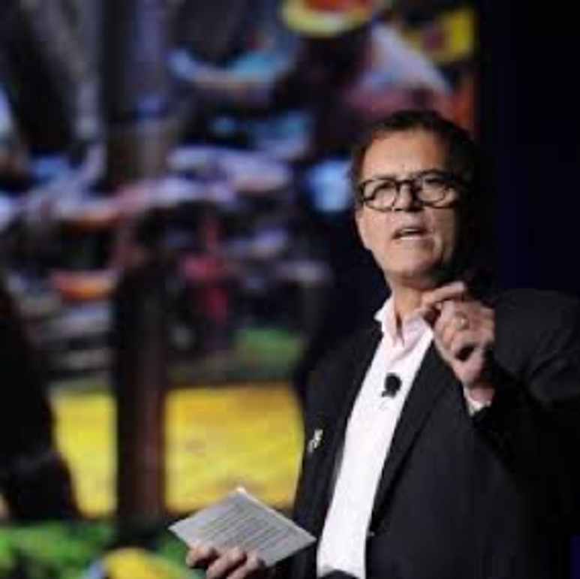
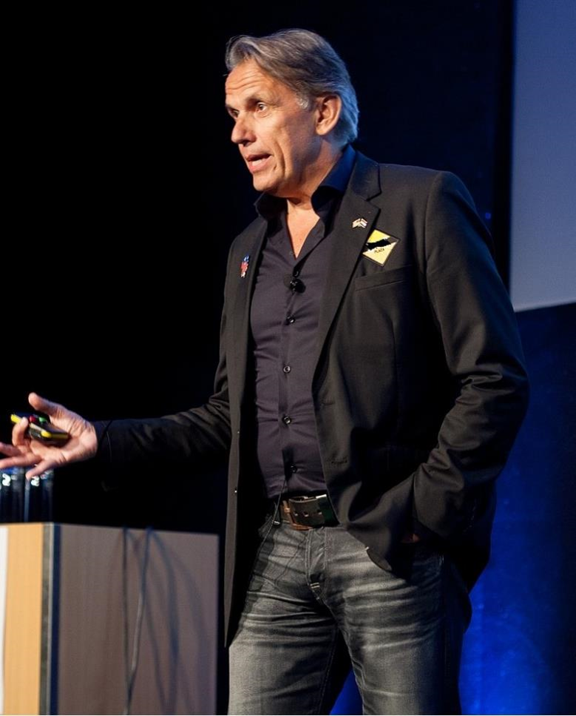
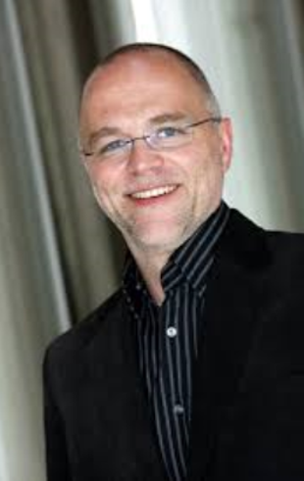
About us
Dik van Brummen
The CloudLab is founded by industry veterans and serial entrepreneurs in the ASP, SaaS and Cloud business, strongly connected with Microsoft. As an experienced team we have a strong track record of building successful cloud companies and creating profitable exits. Our approach is direct, entrepreneurial and very much focused on sustainable results.
Herb Prooy
Rainer Strassner

Slide 3
Amdahl Computer
Apollo Computers
Apricot Computers
Atari
Burroughs
Bull
Commodore
Compaq
CDC
Convex Computer
Data General
Digital Equipment
Honeywell
Next
Nixdorf Computers
Packard Bell
Philips
Prime Computer
Quantex Microsystems
Remmington
Sequent Systems
Siemens
Silicon Graphics
Sperry Univac
Stratus Computer
Sun Microsystems
Tandon Corporation
Tandy Corporation
Texas Instruments
Tulip Computers
Wang Laboratories
Xerox
Zenith Data Systems

Slide 4
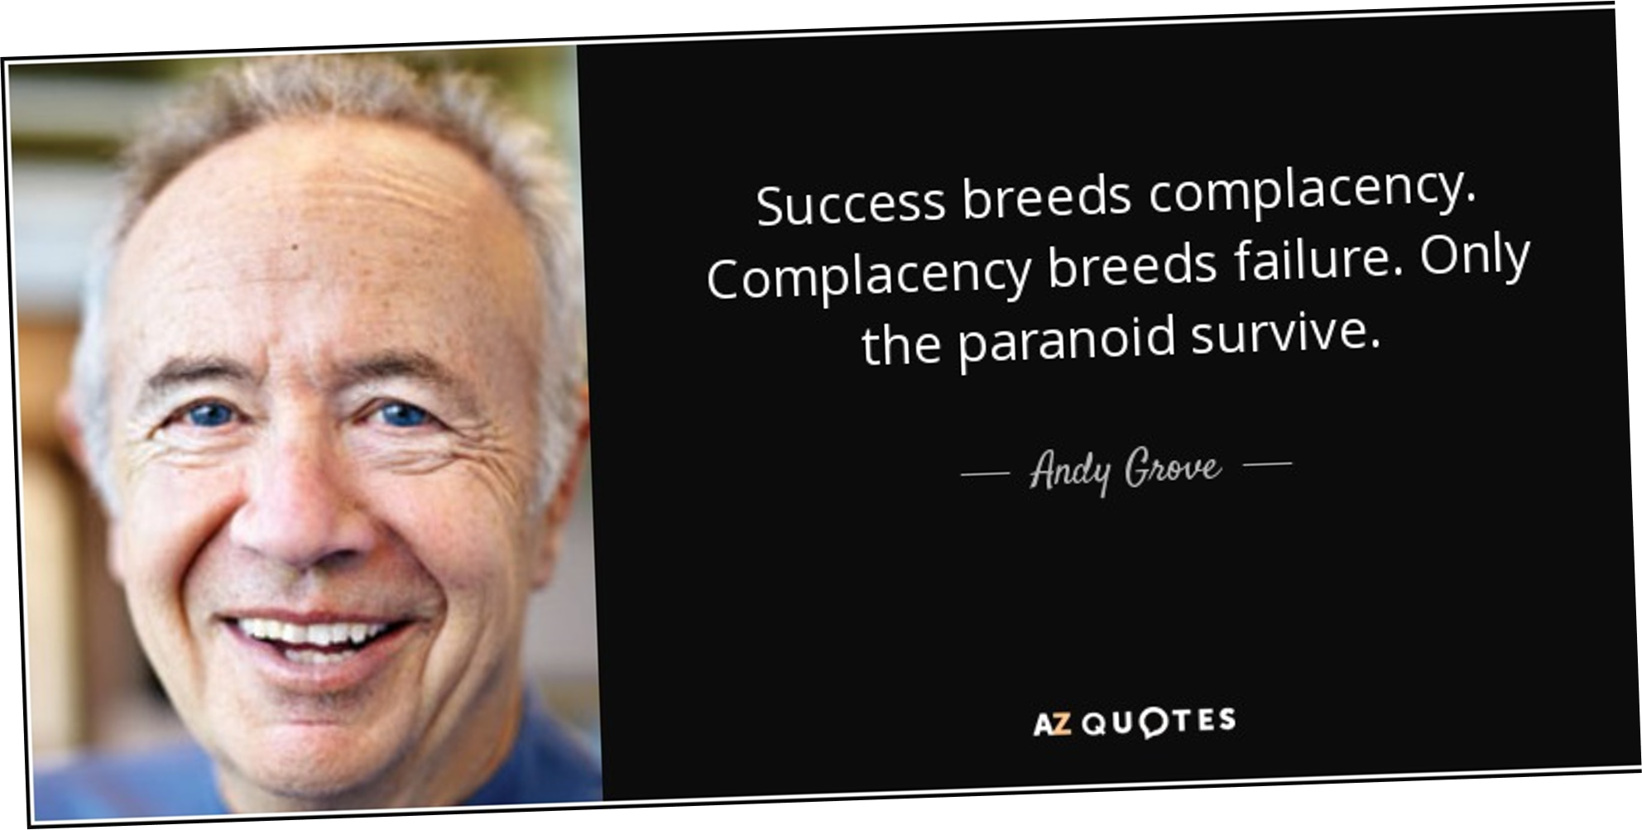

Slide 5
Differentiation
Overall Cost Leadership
Porter’s Generic Competitive Strategies
“ The firm failing to develop its strategy in at least one of the three directions –a firm that is “stuck in the middle” – is in an extremely poor strategic direction”
-Michael E. Porter, 1980
Stuck in the middle
Focus

